Slide 1

X
HaCK ELERATE’ 25
TITLE PAGE
Team ID :KPRHX-1118
Team Name :We-Social Challenges
Project Title : Biometric Authentication for Accident victims using IOT
Domain :Health Care
College :M.Kumarasamy College of Engineering

Slide 2
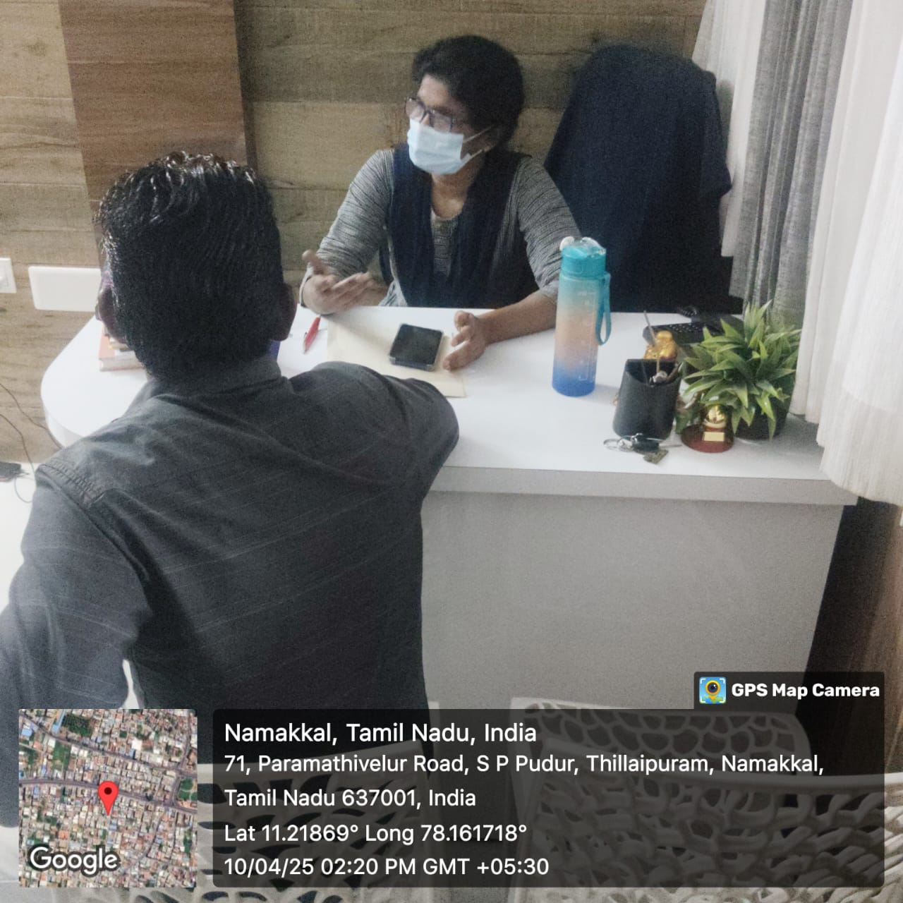
X
HaCK ELERATE’ 25
  PROBLEM STATEMENT
  Literature Survey :
  Difficult to Access the Personal Information during Emergency Situation.
  Lack of Information to Doctors towards Treatment.
  Identified Based on the Survey.
  Our Proposed Solution :
  Patient Information and Health Record Maintaining.
  Personal record Will accessed during Emergency.
  With the Help of Bio-metric Authentication.

Slide 3
X
HaCK ELERATE’ 25
OBJECTIVE
Develop a biometric authentication system for identifying accident victims.
Automate retrieval of medical records in real-time during emergencies.
Node-Red For Connecting Node-MCU
Enhance data security.
Enable timely medical care, even in remote areas.
Minimize human error and support remote healthcare access.
Benefits are only Basic information is accessible by all.
Medical information is only accessible by Doctor.

Slide 4
X
HaCK ELERATE’ 25
EXISTING SYSTEM
  AYUSHMAN BHARAT HEALTH ACCOUNT :Digital Health Records and Consent-Based Data Sharing
  ESANJEEVANI : Medical appointment booking System used mainly for routine teleconsultation it relies on user interaction to start the process.
  Healthcare Professionals Registry (HPR): All verified doctors, nurses, lab technicians details are stored.
  Electronic Health Record : Some Private Hospital Clinic have their own medical record Storing System.

Slide 5
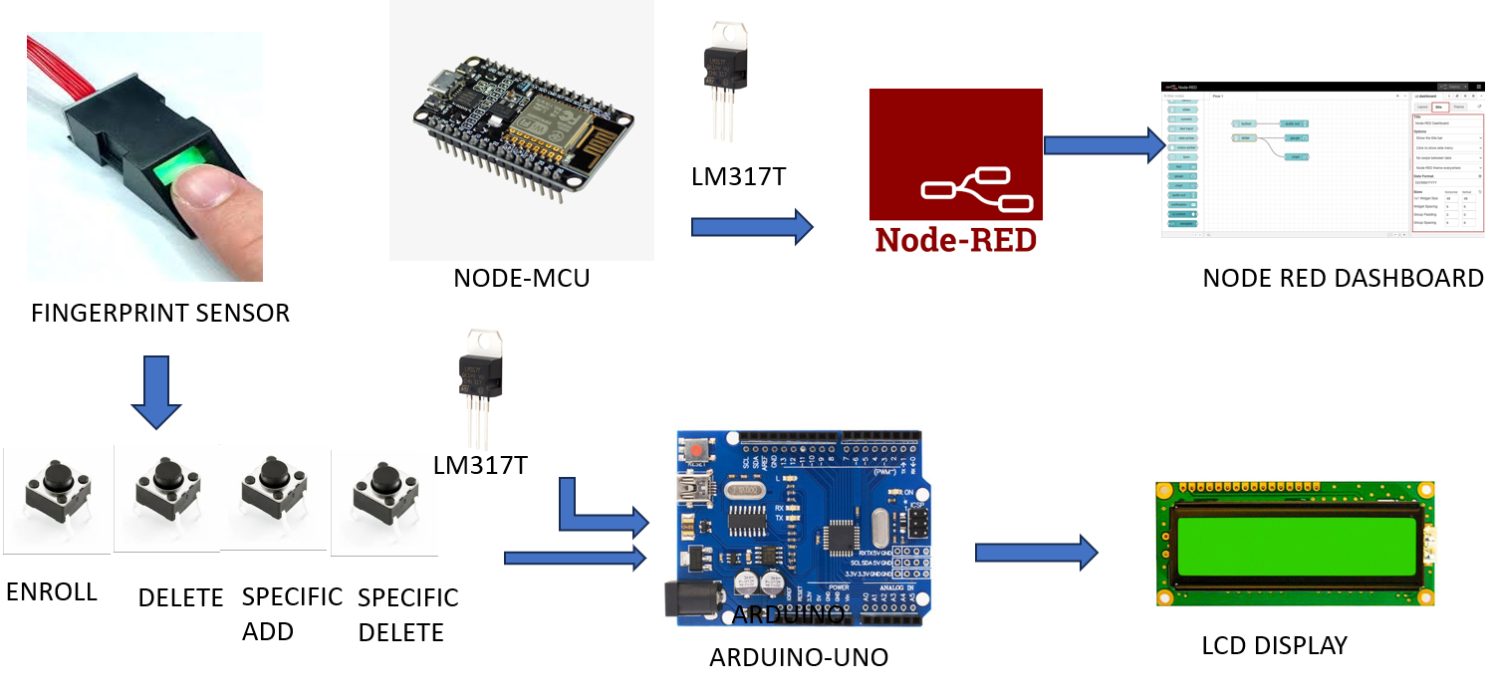
X
HaCK ELERATE’ 25
PROPOSED SYSTEM

Slide 6
X
HaCK ELERATE’ 25
COMPONENTS
HARDWARE
SOFTWARE
Power supply
Finger print sensor
Arduino controller
LCD Display
IOT module
Arduino IDE Complier
Node-Red
Node-Dash-Board Creation
Embedded C

Slide 7
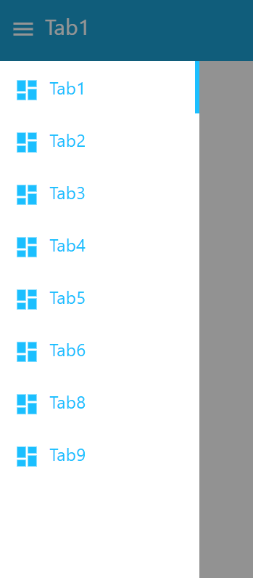
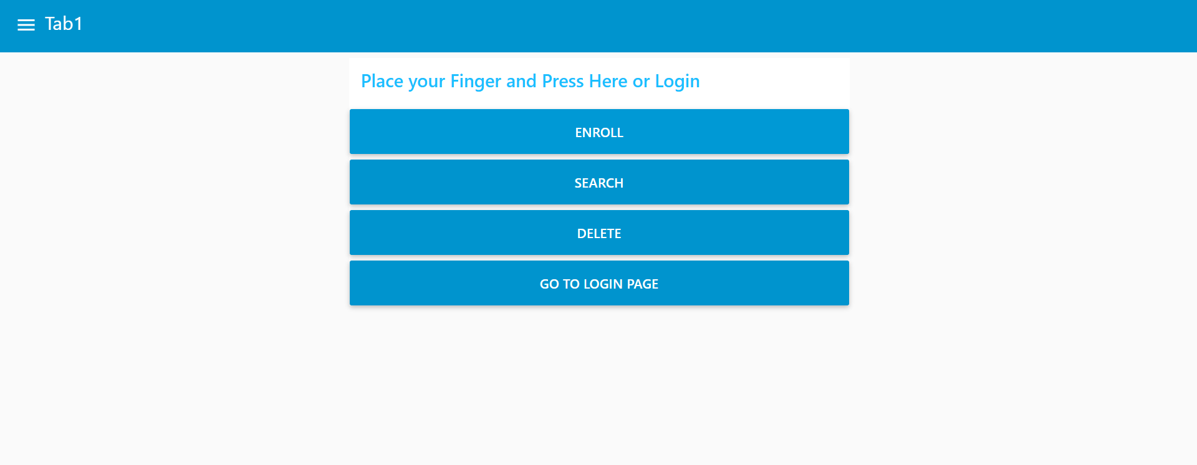
X
HaCK ELERATE’ 25
LOGIN PAGE IN NODE-RED

Slide 8
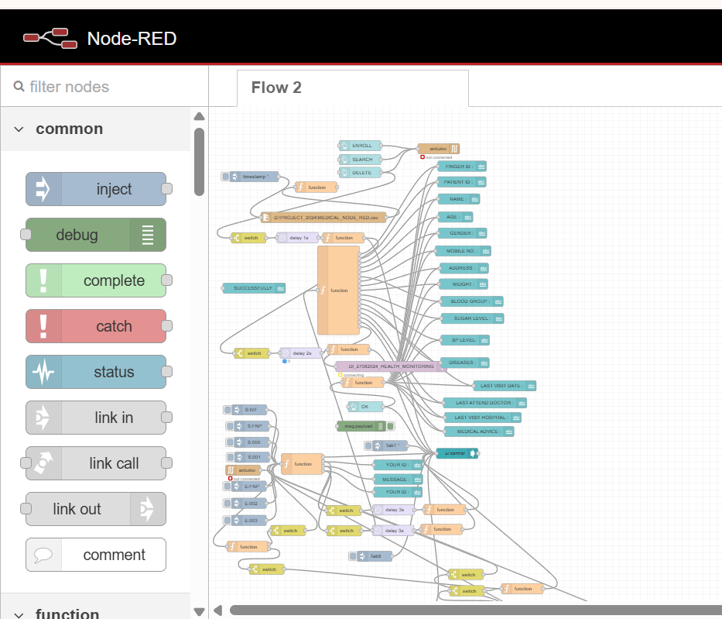
X
HaCK ELERATE’ 25
CONNECTIONS IN NODE – RED FOR CREATING
*ENROLLING THE DATA
*CONNECTED WITH NODE – MCU
*DISPLAYING IN LCD
*DATA BASE ARE CREACTED
*AND UPLOADED IN NODE- RED
*AND CORRECTED IN NODE-HATCH IF ANY DEFAULT

Slide 9
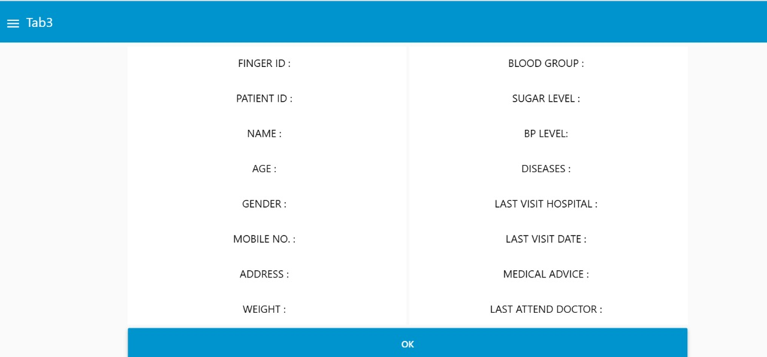
X
HaCK ELERATE’ 25
BASIC DETAIL ACCESSED BY ALL
FLOW -CHART
The Basic web Dashboard is designed Using Node-Red.
Finger-Print is Enrolled
Details Accessed By Biometric Enrolled

Slide 10
X
HaCK ELERATE’ 25
FUTURE SCOPE
FUTURE SCOPE | TECHNOLOGY USED
Send automatic alerts to family members | Using GSM Module(SIM800L)
Locate accident site using GPS | GPS Module , Google Maps API
To implement in place where there is no Internet Connectivity | Using Micro SD card for Offline Identification
Secure identity and data with blockchain | Blockchain Framework(Hyperledger,Ethereum)

Slide 11
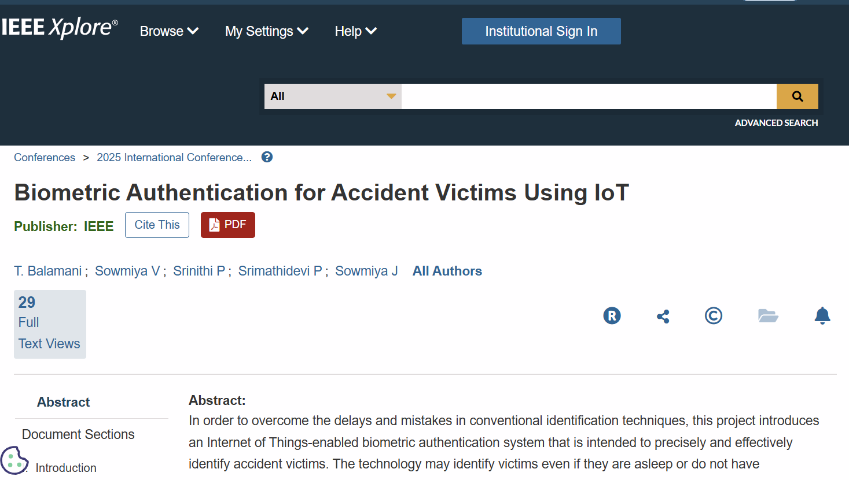
X
HaCK ELERATE’ 25
PUBLISHED PAPER ON IEEE-XPLORE

Slide 12
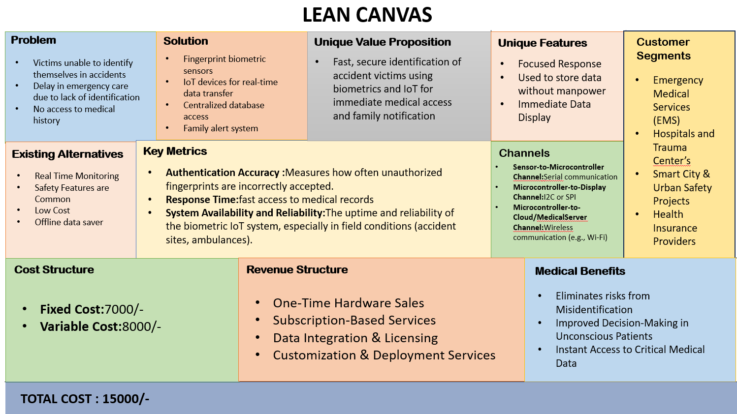
X
HaCK ELERATE’ 25

Slide 13
X
HaCK ELERATE’ 25
REFERENCE
[1] B.Sundar Raj Assistant professor, “A Third Generation Automated Teller Machine Using Universal Subscriber Module with Iris Recognition”, IJIRCCE, Vol. 1, Issue 3, May 2013.Q. Cao and C. Giannetti, “KSPMI: A Knowledge-Based System for Predictive Maintenance in Industry 4.0”, Robotics and Computer-Integrated Manufacturing, Vol. 74 pp. 1-13, 2022.
[2] Geovanny P. Guano, Darwin Alulema, Enrique V. Carrera, “A portable electronic system for health monitoring of elderly people”, Communications and Computing (COLCOM), 2015 IEEE Colombian Conference.
[3] Savita Choudhary, Assistant Professor, “Design of Biometric Based Transaction System using Open Source Software Development Environment”, IJIRCCE. Vol.2, Special Issue 2, May 2014.
[4] N. Kiruthiga a, L. Latha b, S. Thangasamy, “Real Time Biometrics based Vehicle Security System with GPS and GSM Technology”, Procedia Computer Science 47 (2015) [5] Naina Kaushik, Mayur Veralkar, Pratik Parab, Kedar Nadkarny, “Anti-Theft Vehicle Security System”, IJSRD, Vol. 1, Issue 12, 2014

